Slide 2
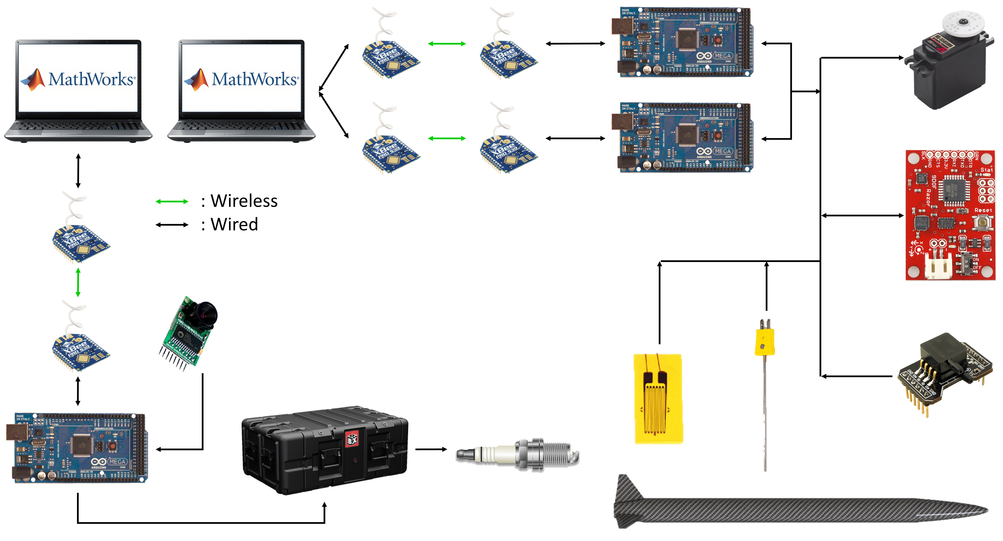
Data & Communication Systems Architecture
SD card may be mounted to Arduinos in case LOS is lost
XBees transmit 900MHz at 200 kbps at 4 miles
Conceptual Design
Electronics & Payload

Slide 3
Command Structure
Use launch operations computer to send command to launch box or vehicle
MathWorks includes support package for Arduino communication
Arduino receives command then sends back that it received command
If Arduino does not acknowledge, we will know to send command again
Arduino sends status update when command is completed
In case of sensors, data collection begins
In case of one-time command, a short message is sent
Conceptual Design
Electronics & Payload

Slide 4
Sensors
Necessary for testing and flight data collection
Vehicle will contain an IMU, two pressure sensors, and three thermocouples
May also support payload
Data will be read in from the Arduinos
The system is flexible enough that additional sensors can be easily added on to the system for testing or normal flight operations
Conceptual Design
Electronics & Payload

Slide 5
Power Requirements
Sensor | Voltage | Current | Power | Quantity
Thermocouple | 3.3 V | Negligible | N/A | 3
IMU | 3.3 V | 1.2 mA | 3.96 mW | 1
Strain Gauge | 5 V | 100 mA | 500 mW | 2
Pressure Transducer | 12 V | 10 mA | 120 mW | 2
Arduino | 5 V | 25 mA | 125 mW | 2
XBee | 3 V | 95 mA | 285 mW | 2
Flight Total: | - | 461.2 mA | 2.064 W | 12
Will be utilizing last year’s battery
Arduinos require 5V so must be wired to regulator
Arduinos require much less power than BeagleBones so have plenty of energy to spare with last years battery
This means any additional sensors added do not cause a concern with regard to power
Conceptual Design
Electronics & Payload
Notes:
Arduinos are able to output 500 mA each

Slide 6
Testing
Successfully transmitted data between Arduinos via XBee
Two-nodal communication, not ZigBee
Successfully read in calibrated data from thermocouples
Successfully read in calibrated data from IMU
Waiting on pressure sensor selection
Will begin testing servo motor for propulsion soon
Conceptual Design
Electronics & Payload

Slide 7
Propulsion Safety Shutoff
Propulsion would like the feature of an automatic engine shutoff should sensor data fall outside of acceptable bounds
Data from failing rocket would trigger the Arduino to close the ball valve
Arduino would check IMU, temperature, and pressure data to determine if shutoff was necessary
Could potentially save rocket from critical failure while causing only a premature shutdown
Conceptual Design
Electronics & Payload
Notes:
Data in sensors is inherently “jumpy” so multi-data-point average necessary for useful data
Thorough testing of IMU necessary to test for drift
Speed of ball valve closure greatly determines effectiveness of such measures

